Slide 1

Welcome!
to Microsoft University on Azure Cloud Platform

Slide 2
Michael Whitehouse
mike@michaelwhitehouse.com
@kramit Twitter
Github.com/kramit

Slide 3
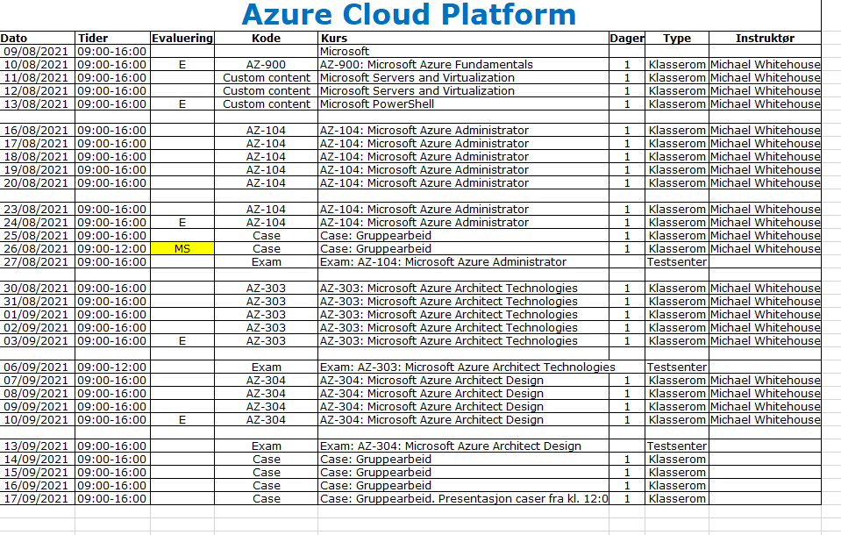
YOU ARE HERE

Slide 4
Agenda
Networking review
Security and Identity
System automation with PowerShell
Virtualization and Cloud basics

Slide 5
Networking
basics
topologies
standards
addressing
tools
Notes:
bus, star, ring, hybrid
ISO Open Systems Interface
addressing
MAC
IPv4, subnetting
Public / private (10.0.0.0/8, 172.16.0.0/12, 192.168.0.0./16)
manual, DHCP, APIPA
ARP
IPv6, Unicast / Multicasting / Anycast, link-local / unique local / unique global
Devices
Lions and Tigers and Bears. Oh, my!
Routers and Switches and Hubs. Oh, my!
Ipconfig, ping, tracert

Slide 6
DNS
structure
zones, name servers, replication
DNS server settings
tools
Notes:
nslookup, ipconfig /flushdns,

Slide 7
Active Directory
schema, objects, attributes
forests, trees, domains, trusts
DCs, GCs, sites, replication, RODCs
single master operations

Slide 8
AD roles
Lightweight Directory Service
Rights Management Service
Federation Services
Certificate Services

Slide 9
users
create groups
create users
secure logon
apply policies
control permissions
grant access to resources

